Slide 1
Customer Analytics
Customer Lifetime Value Analysis
Priyanka Shrivastava, PhD
St. Mary’s college of California

Slide 2
Customer Lifetime Value
$6 revenue per visit X 200 visits / year = $1200
$3 Profit per visit X 200 visits / year = $600
This customer stays with the company for next 20 years
Profit by the customer = 600 X 20 = $12000
Acquisition cost= $5000
Customer Life time value = 12000-5000 = 7000
2

Slide 3
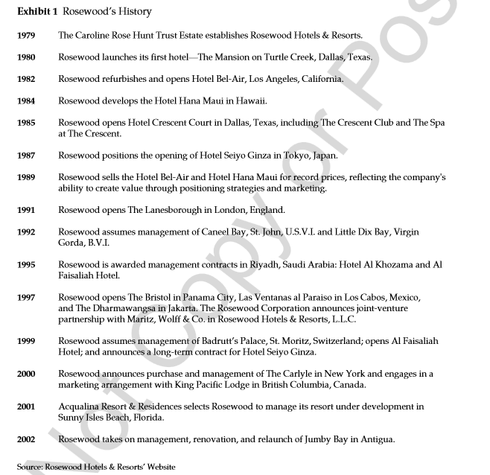
3

Slide 4
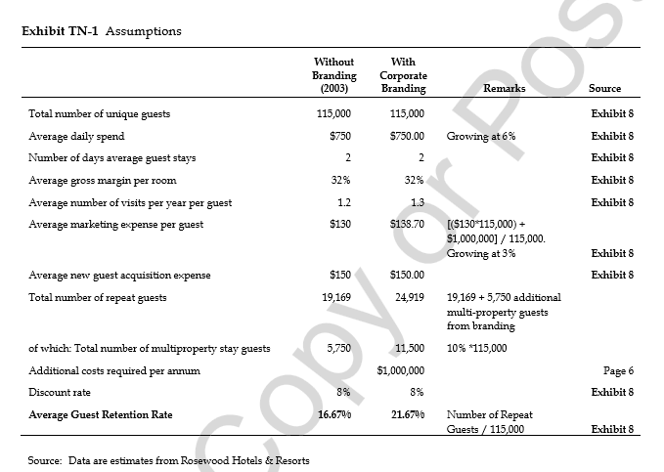
Notes:
http://www.personicx.co.uk/personicx.html#

Slide 5
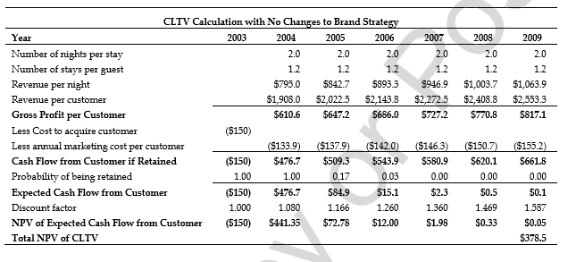

Slide 6
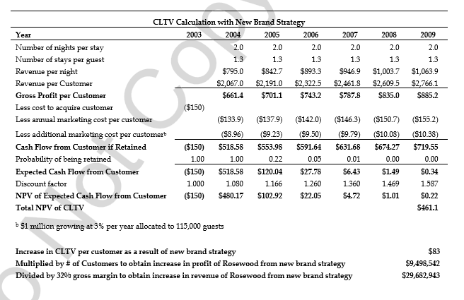

Slide 7
Thank You!

